Slide 1
TRACE report template - how to use
Make a copy of this slideshow before you enter any of your information
Feel free to add / remove any of the slides to personalise your report
Download your chosen graphics from the TRACE event dashboard
Certain graphics are screenshots not downloads
Delete this slide
Any issues - email support@traceyour.events

Slide 2
[Insert Event Name]
Sustainability Report
[date]

Slide 3

Contents
Event Overview
Sustainability Objectives
Emissions & Waste
In more detail…
Successes
Challenges and Opportunities
Recommendations
Further Actions
eve

Slide 4

Event Overview
[Project no.]
[Event Name]
[Event Date]
[Event location / venue]
Notes:
(Slide 1 )Full change
- event overview
(Slide 2) Sustainability goals and measurement
(Slide 3) How did we do / Key details / Performance review
Overview topline
Individual deep dives/ breakdowns
(Slide 4)
Challenges / Reporting limitations
(Slide 5)
Key successes - maybe 4 and 5 switch places
(Slide 6)
Further actions

Slide 5



Sustainability Objectives
Objective A
Objective B
Objective C

Slide 6
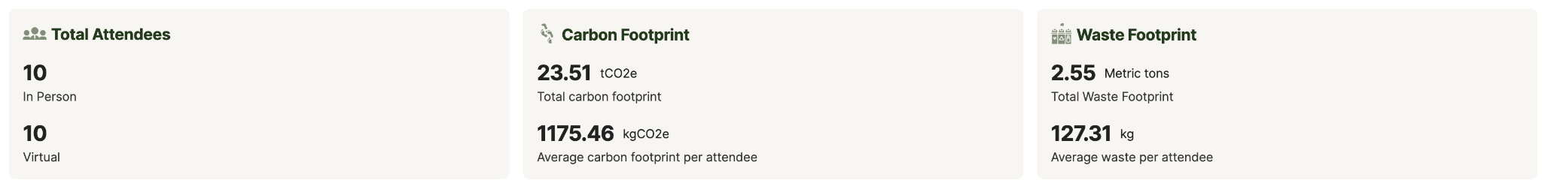
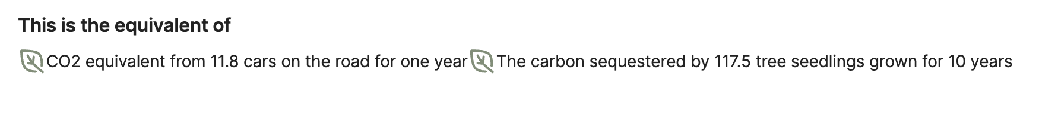
Emissions and Waste How did we do?
Add your own downloads
general-headlines
Waste-Waste_Emission_Stats
What does this mean?
general-Equivalent-Emissions
*Some of the outcomes in this report are based on estimated data.
This is clearly marked and all data was collected to achieve the best quality available

Slide 7
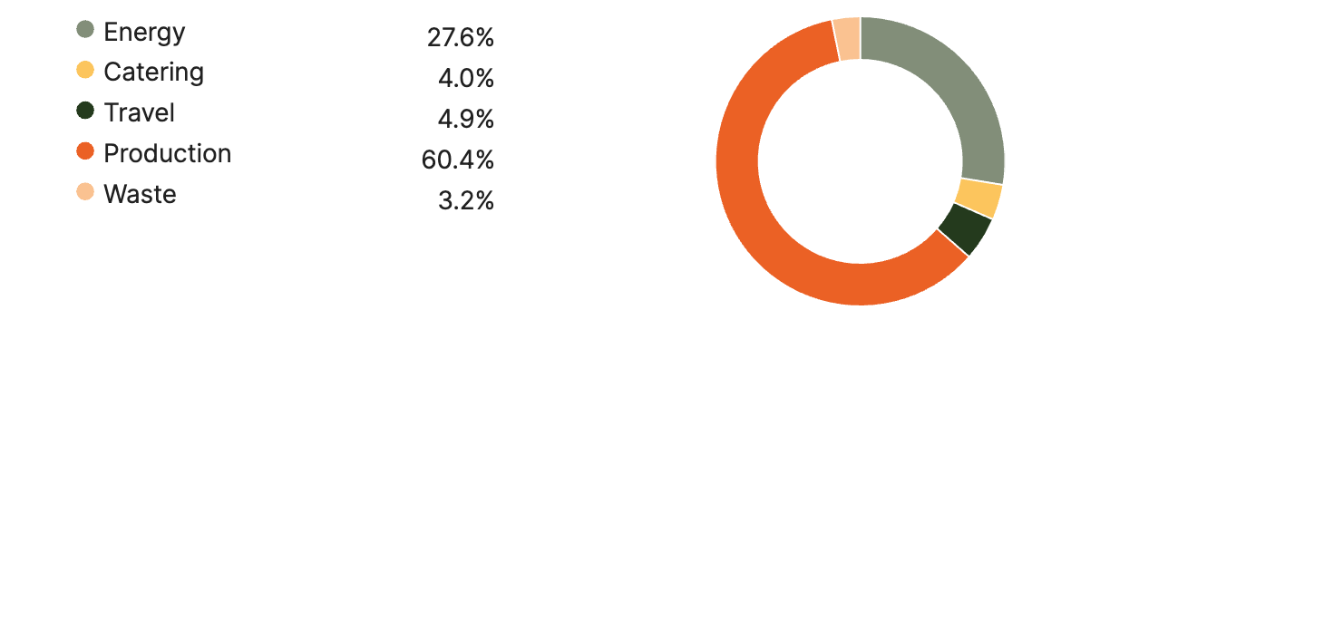
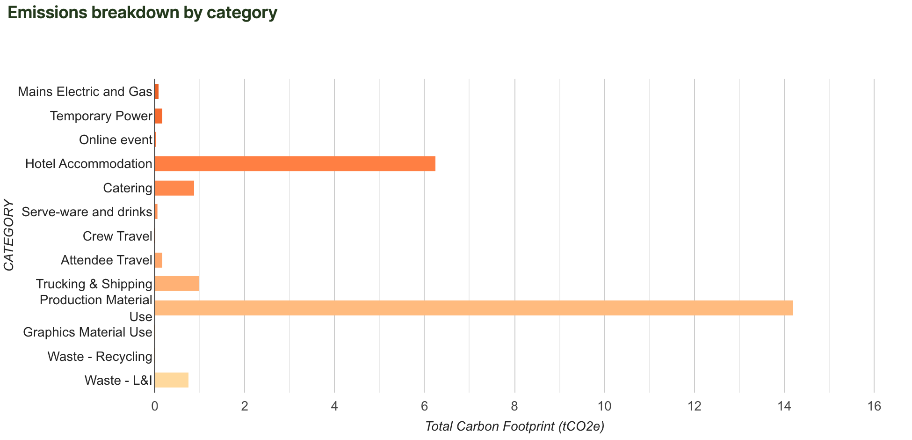

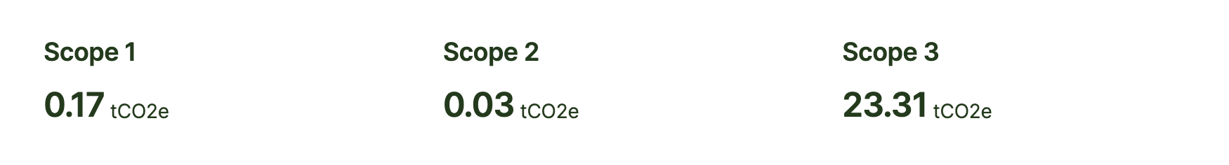
Emissions cont…
general-Carbon-Footprint-by-Category-section
general-Emissions-Breakdown-by-Category
general-scope_data
Notes:
[INSERT DOWNLOADABLE PNG IMAGES FROM TRACE AS ABOVE]

Slide 8


In more detail…
Notes:
Number 2 is - Talk openly

Slide 9
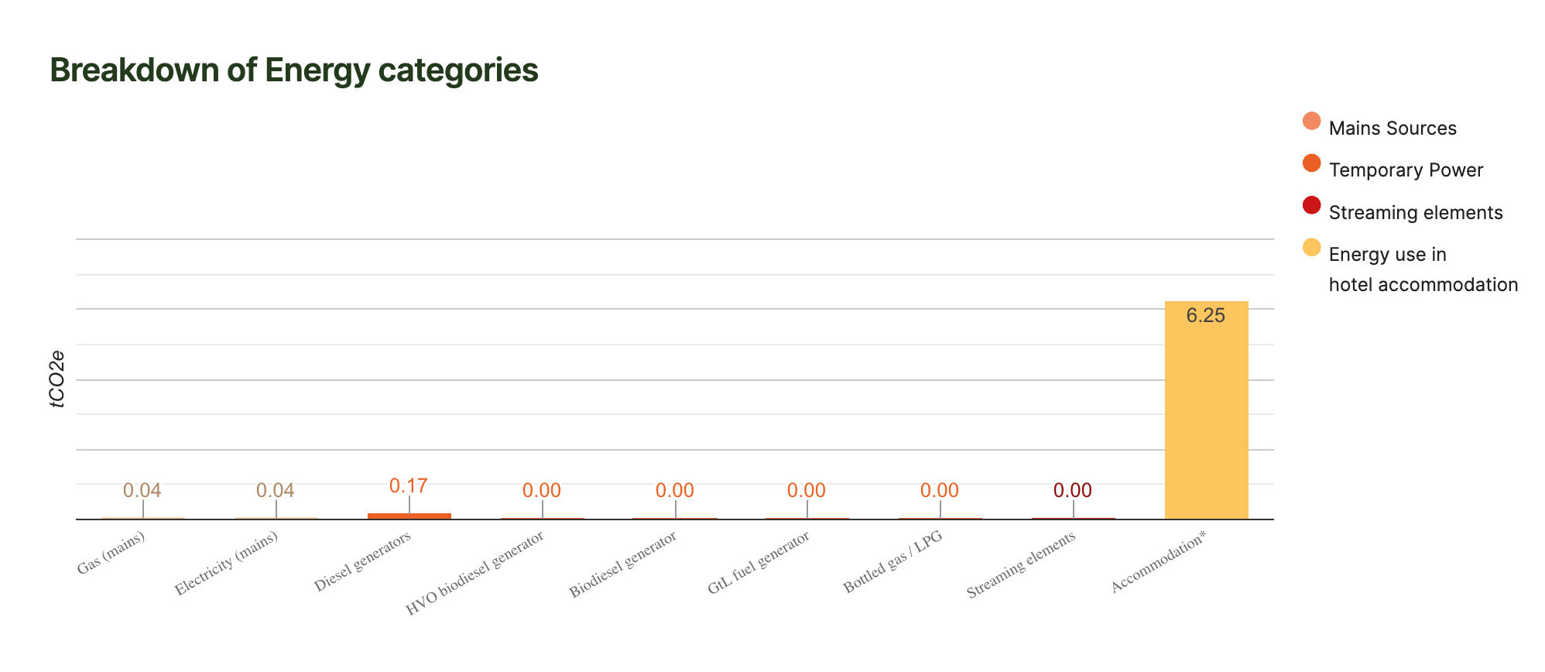
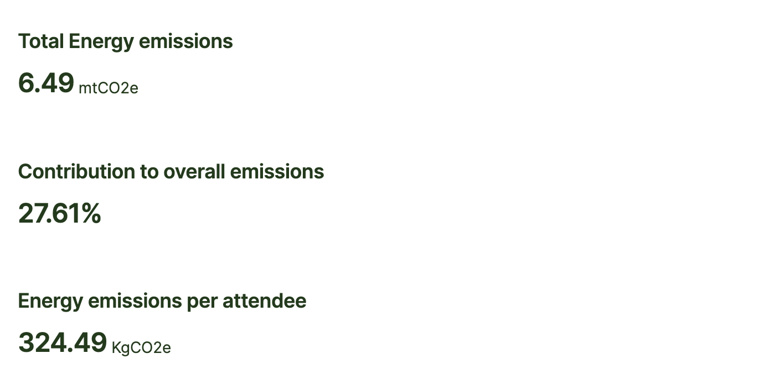
Energy
Findings & Considerations
E.g Gas was the highest contributing factor to energy emissions. Fur future events, we can discuss with venues about setting upper and lower bounds for HVAC system to kick in for heating and cooling during build.
Energy-Energy-Carbon-Footprint-Breakdown
Energy-Energy-Emission-Sec
Notes:
[INSERT DOWNLOADABLE PNG IMAGES FROM TRACE AS ABOVE]

Slide 10
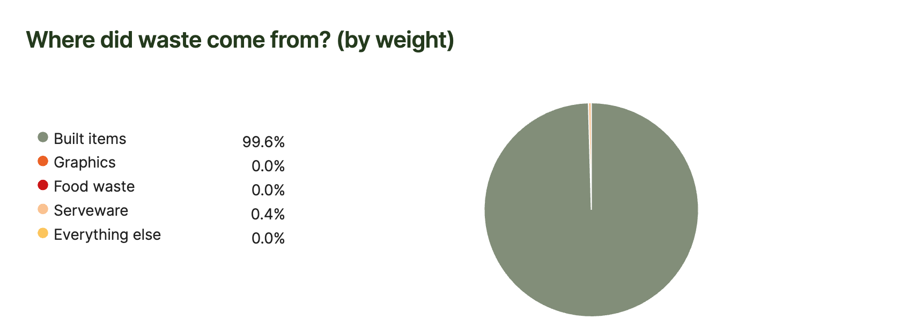
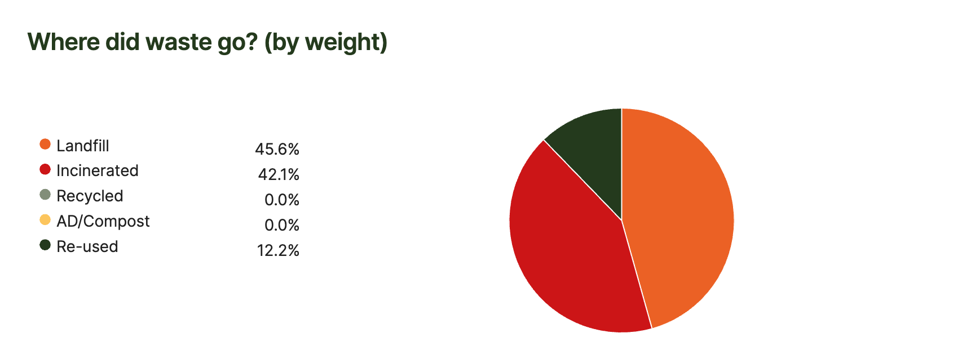
Waste
Findings & Considerations
Eg The majority of our waste has come from built items. We are looking into how much of our build can come from hired or reused places for future events
Waste-chart-w1
Waste-chw2-full
Waste-Waste_Emission_Stats
Notes:
[INSERT DOWNLOADABLE PNG IMAGES FROM TRACE AS ABOVE]

Slide 11
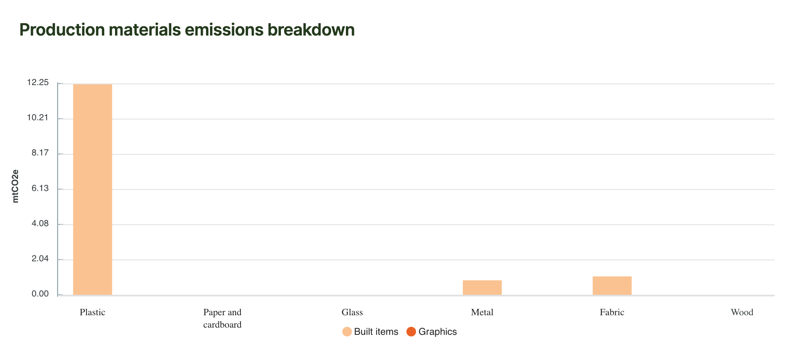
Production
Findings & Considerations
Production-production_bar_chart
Production-Production_Emission_Stats
Notes:
[INSERT DOWNLOADABLE PNG IMAGES FROM TRACE AS ABOVE]

Slide 12
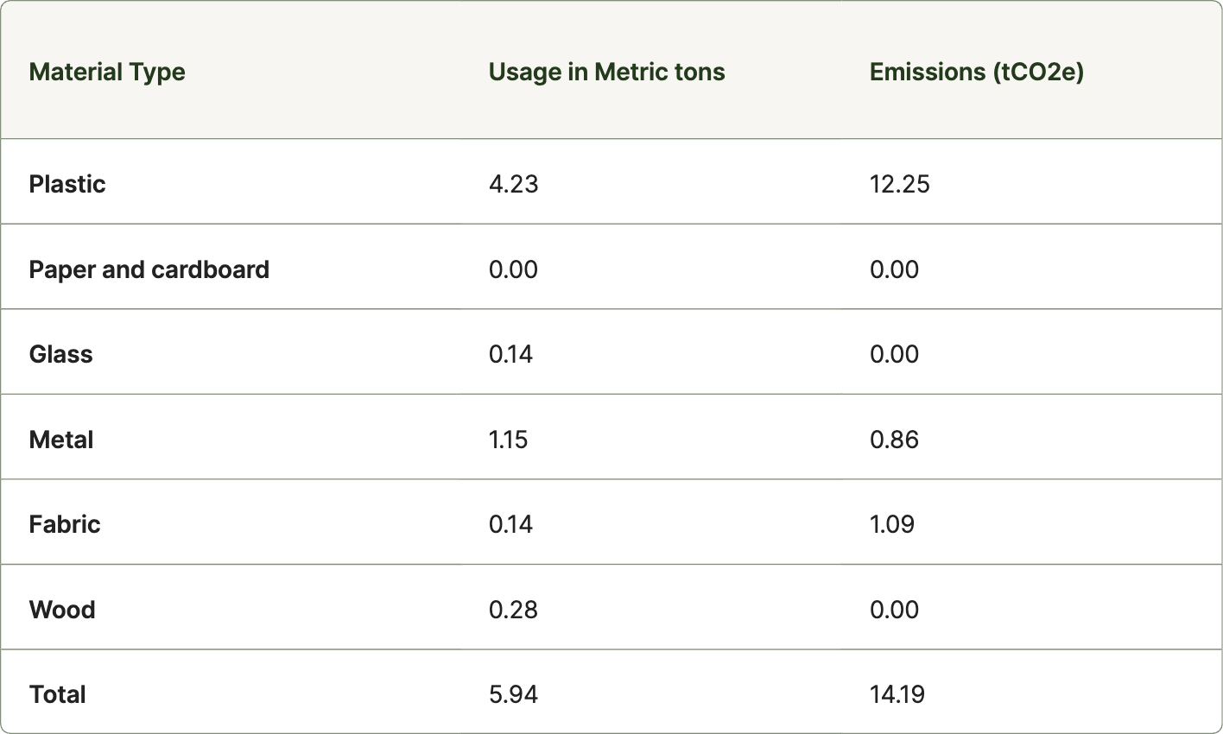
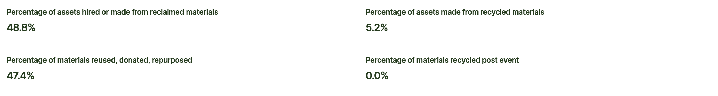
Production
Production-Production_Emission_Table
Findings & Considerations
Eg As we were required to produce a completely new build for the event we tried to counter our emissions by reusing/donating upwards of 82% of our materials
Production-Production_Material_Percentage_Stats
Notes:
[INSERT DOWNLOADABLE PNG IMAGES FROM TRACE AS ABOVE]

Slide 13
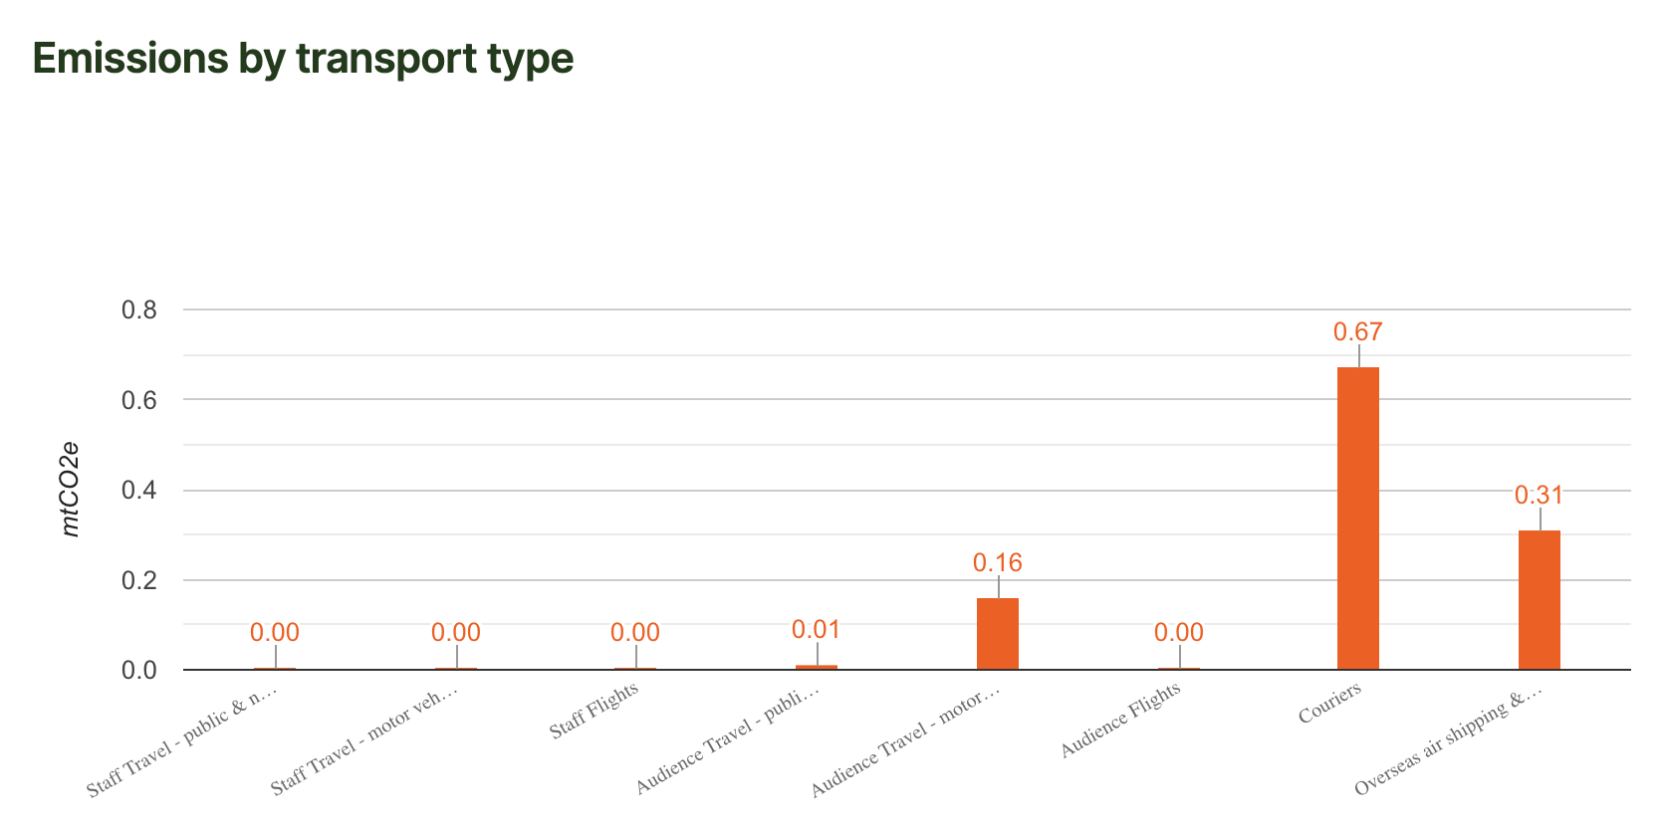
Travel & Transport
Transport-chart-t1
Findings & Considerations
Eg From a survey conducted of 100 participants on entry to the event
Transport-Travel_Emission_Stats
Notes:
[INSERT DOWNLOADABLE PNG IMAGES FROM TRACE AS ABOVE]

Slide 14
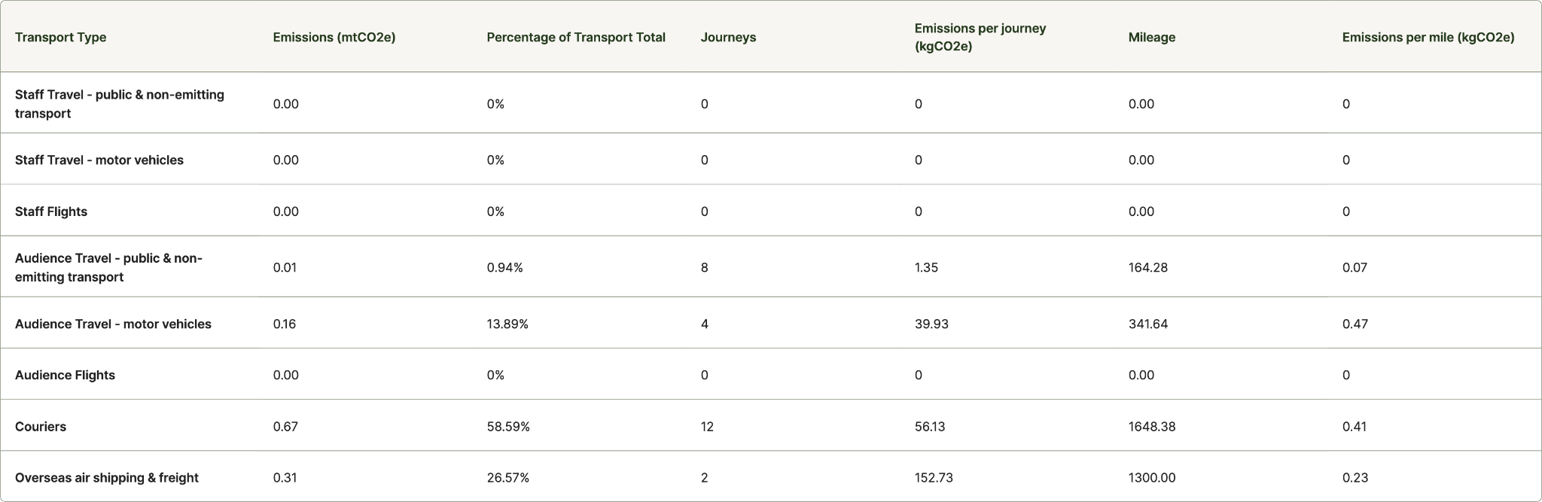
Travel & Transport
Transport-Travel_Table
Notes:
[INSERT DOWNLOADABLE PNG IMAGES FROM TRACE AS ABOVE]

Slide 15
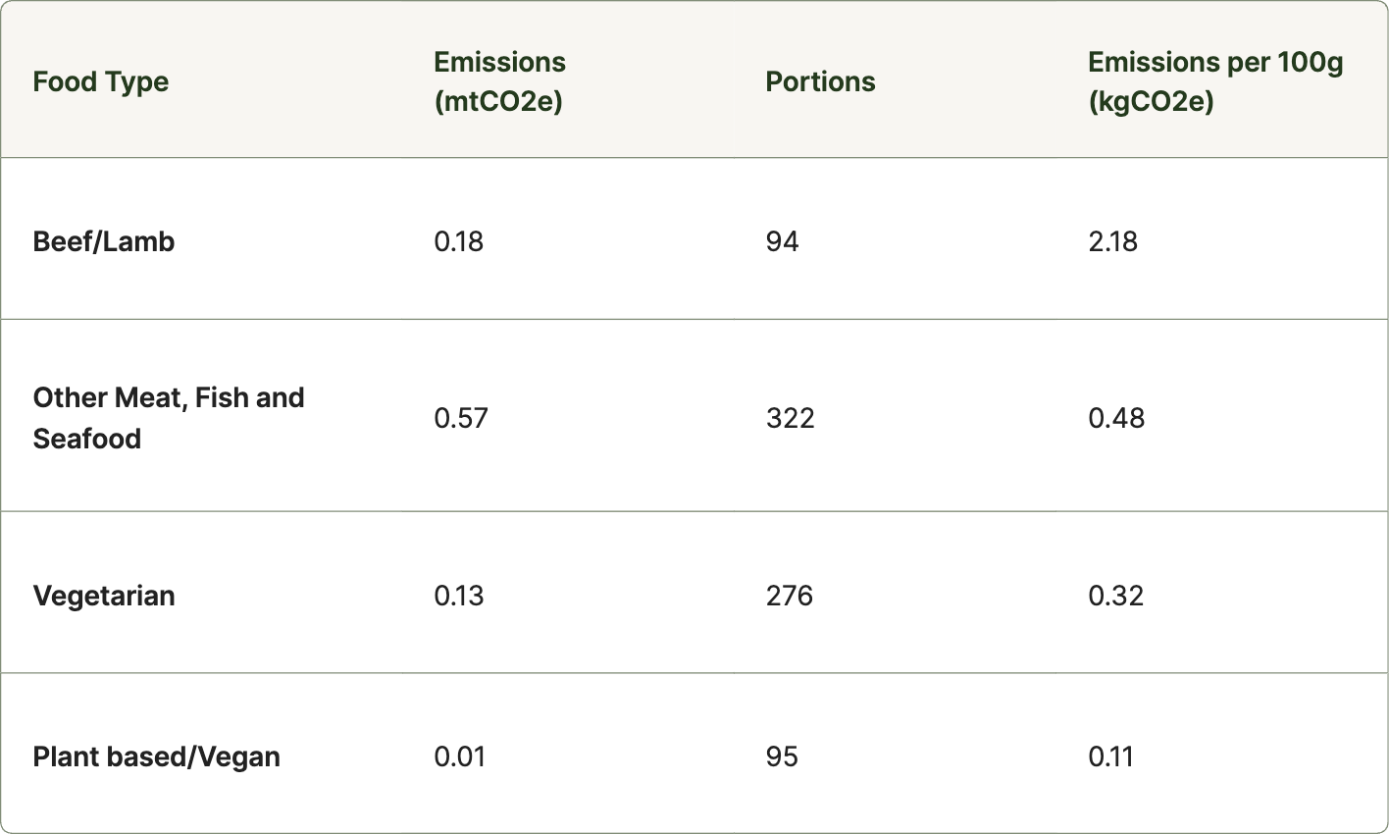
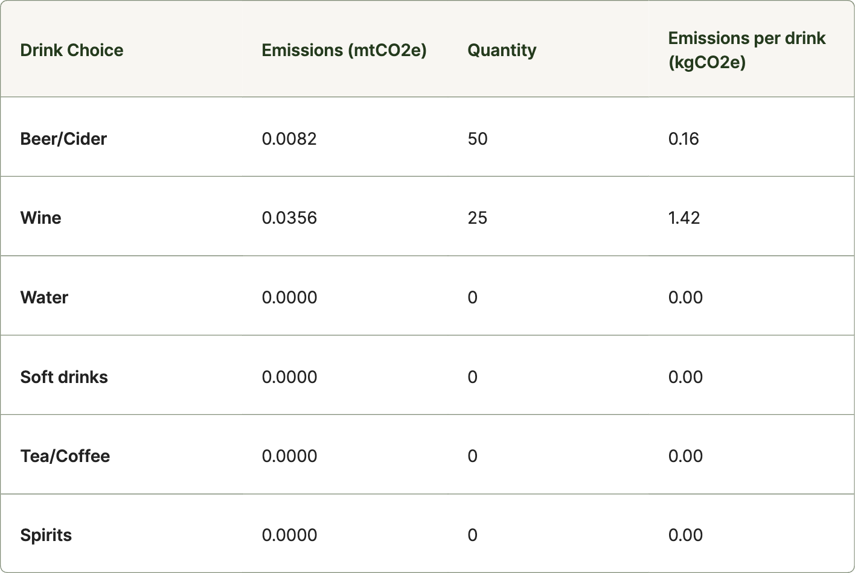
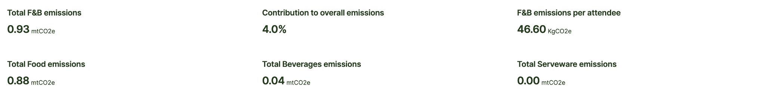
Food & Beverage
Food_Drink-Catering_FoodType_Table
Food_Drink-Catering_DrinkType_Table
Food_Drink-Catering_Emission_Stats
Notes:
[INSERT DOWNLOADABLE PNG IMAGES FROM TRACE AS ABOVE]

Slide 16
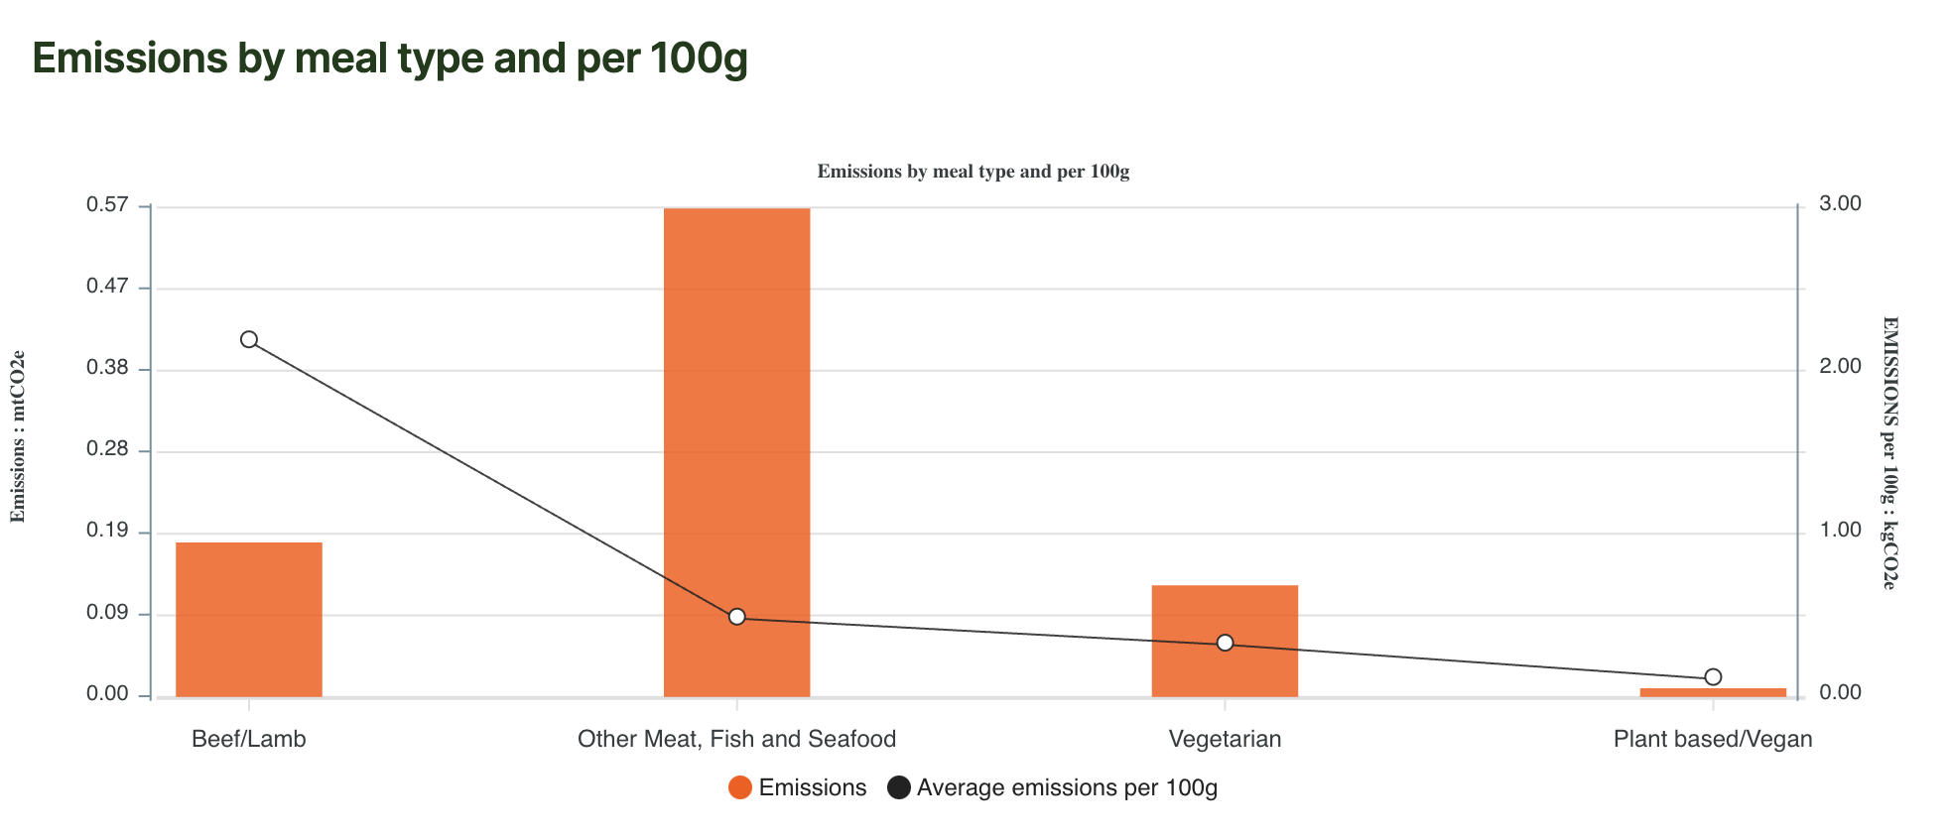
Food & Beverage
Findings & Considerations
Food_Drink-catering_line_chart_1
Notes:
[INSERT DOWNLOADABLE PNG IMAGES FROM TRACE AS ABOVE]

Slide 17
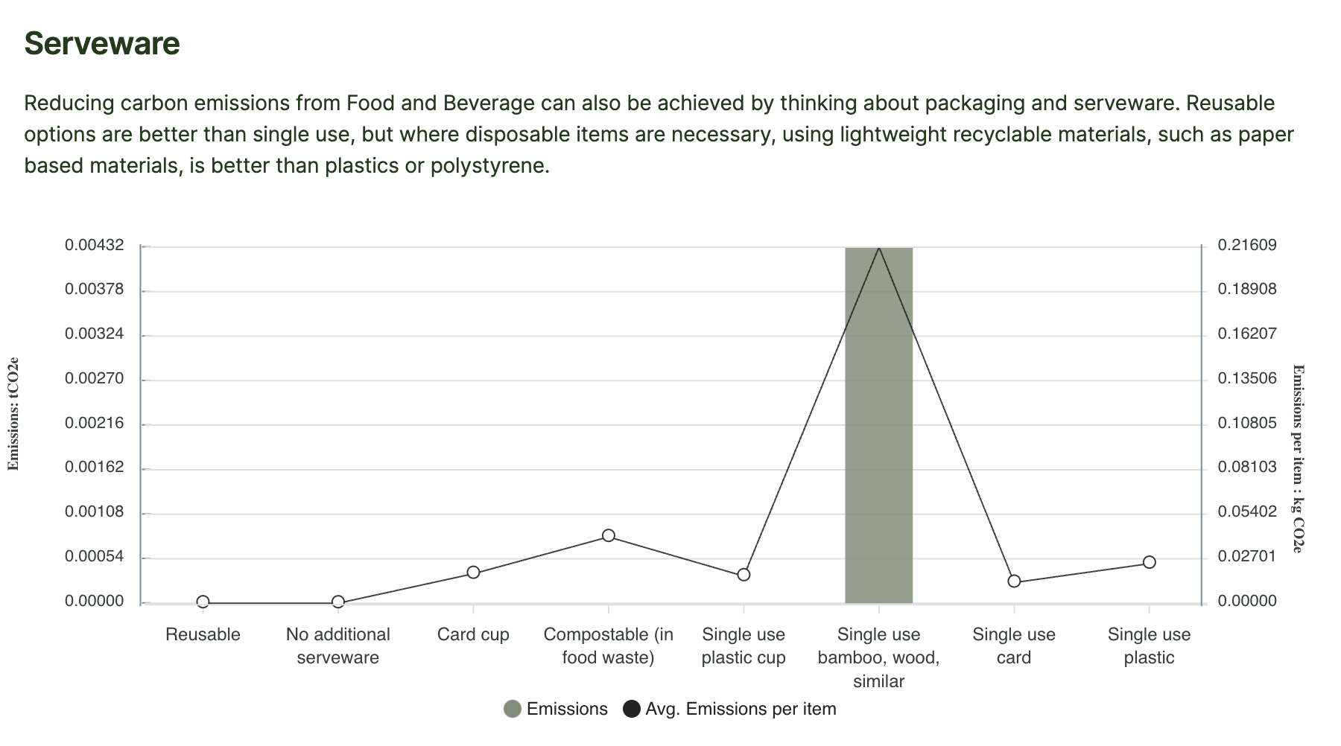
Serveware
Food_Drink-serveware-chart
Findings & Considerations

Slide 18
Successes
Did you meet your sustainable goals? Or use this space input any sustainable choices that you were unable to add into TRACE
Success A
Success B
Success C

Slide 19
Challenges & Opportunities
What challenges did you face? And what is the learning / opportunity for overcoming this challenge nxt time?
Opportunity
Challenge
Opportunity
Challenge
Opportunity
Challenge

Slide 20
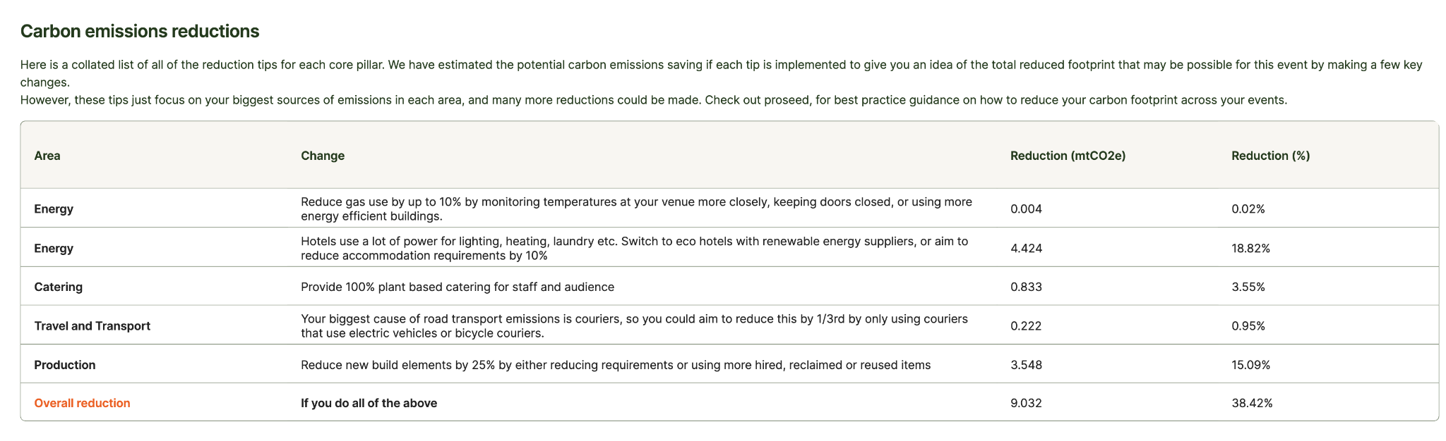
Recommendations
Reduction-reduction-tbl-full
Reduction-Reduction_Emission_Stats
Reduction-Reduction_Emission_Stats2
eve

Slide 21
Further Actions
Balancing emissions - Options
ECOLIBRIUM
The investment is split into three parts. Each £15 helps to offset 1 tonne of carbon through planting trees with Forest carbon but also protects 1 acre of Rainforest with the Rainforest Trust and supports Temwa, a charity in Malawi to plant 3 trees and provide other social benefits.
EARTHLY
A trusted community that connects businesses to high-quality nature-based solutions that remove carbon, restore biodiversity & support local communities.
Other actions
Do you have your own programmes or partners that you work with?

Slide 22



Here’s why it matters…
It’s a business driver
Your people want it
Attendees want it
4.2 out of 5 employees feel it’s important to work with clients that want sustainable event solutions
4.3 out of 5 employees feel it is important to work for an organisation that can demonstrate commitment towards improving the sustainability performance of events they deliver.
4.3 out of 5 employees feel it is to deliver a sustainable event (regardless of the practicality of this.)
94% think that sustainability should form part of annual company targets and KPIs.
→ Drive competitive advantage through stakeholder engagement
→ Build client loyalty and a roster of clients with aligned ethics
→ Attract and retain talent with similar values
→ 74% of people want a green recovery*.
→ 86% of 2000 people across China, US and UK expect businesses to help solve problems like the climate crisis
→ 75% say that Covid-19 has raised their expectations of business to tackle climate **
*IPSOS MORI
*Wunderman Thompson
*From isla surveyed employees of member organisations

Slide 23
Thank you

